Slide 1
IOT APPLICATIONS IN TRANSPORTATION
Group 5: PRADYOT KHER
S AKASH
SUBRAMANIYAN
ACHYUT RAJU MADHAVAN
PRIYA DUTTA
DIBYAJYOTI DEBATA
ANWESHA PALIT
CHINNARI VENKAT ABHIJEET
RHEA MANTRI
Presenters: PRADYOT KHER
SUBRAMANIYAN
S AKASH

Slide 2
What is IoT ? How it is used in the Transportation sector?
IoT refers to the connection of your physical device to the Internet. The Internet of Things refers to a set of interconnected computer devices embedded in various objects ranging from mobile devices to household applications .
IoT has the potential to transform the transportation sector by altering how transportation systems gather data and information by bringing together major technical trends of automation and data analysis. It will basically include the interfacing of Embedded sensors, actuators and other devices that can collect and transmit information in real-time activity in the network.

Slide 3
So in most of the transportation based applications of IoT embedded sensors are used which collect data and the data is then either analysed for improving user experience or it is stored in a cloud database for the users to retrieve the data for their personal requirements.

Slide 4
IoT Applications in Transportation Sector
We can book tickets like flight , bus just through our phone using the Google Assistant.
User being able to track a flight, bus or even a car by sitting at home.
Live traffic monitoring
Auto-Breaking System in cars

Slide 5
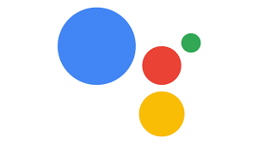
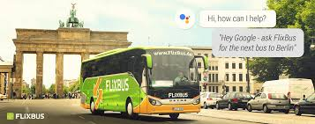
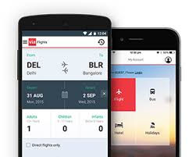
Booking Tickets

Slide 6
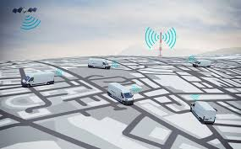
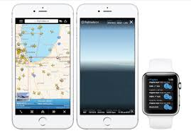
Tracking vehicles

Slide 7
Auto-breaking systems in Cars
IOT can be used in the automobile industry as it fulfills the purpose of a sensor installed in a vehicle that automatically applies breaks if there is a barrier too close to the vehicle. In this way accidents can be avoided.
The sensors used in these systems are as follows:
Ultrasonic Sensor - Gives information about distance
Hall Sensor- It is a transducer that varies its output in response to the changes in magnetic field density. These are used for proximity switching, positioning speed detection.
Microcontroller - To receive data from the sensor and communicate with the peripherals
Bluetooth Module - Used for wireless serial communication

Slide 8
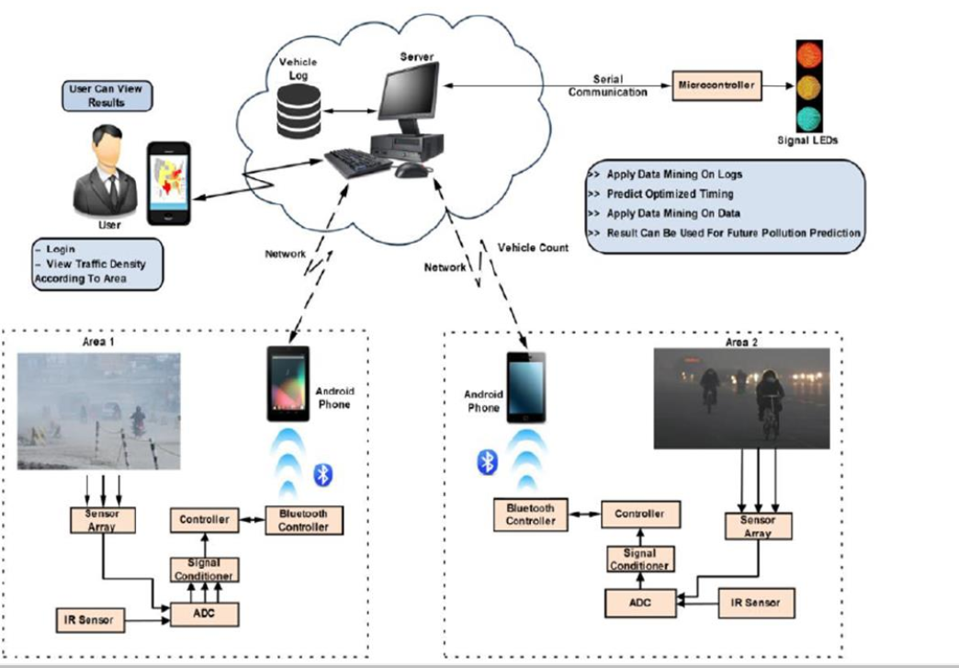
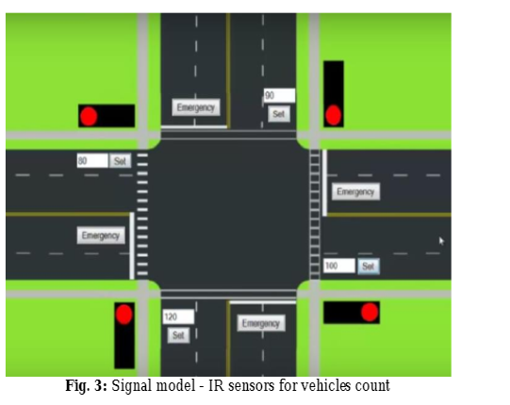
IoT in Traffic Management System

Slide 9
Traffic Monitoring System–TMS using multiple IRs in IOT model to learn vehicles count in real time then updates signal timing of every side traffic lights according to the predicting factors using KNN algorithms. It uses IRs to collect signals from numerous inputs on basis IOT model setup to learn vehicles count available in a traffic signal. So it will get cleared depends on the dependability of vehicles count to either increase or decreases timing of particular signals using KNN algorithms by data analysis.

Slide 10
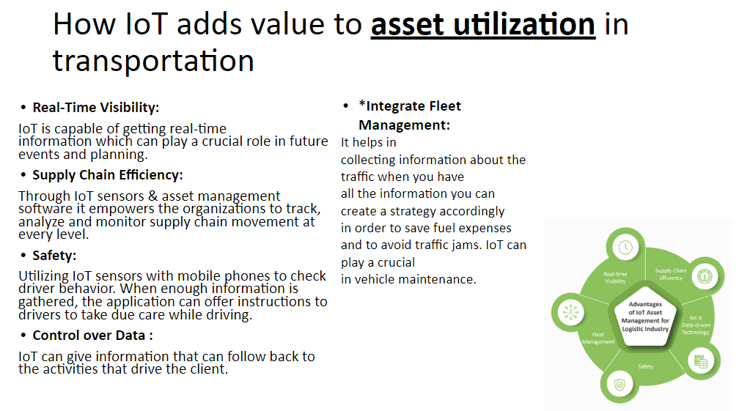

Slide 11
Case Study Examples: Transit and Automotive IoT Solutions
SEPTA: Positive Train Control (PTC)
Transportation Authority (SEPTA) provides light rail, subway and bus service to more than one million riders daily in the US.
SEPTA was one of the early transit systems to mobilize their Positive Train Control (PTC) installation, a sophisticated train-signaling system designed to prevent crashes, derailments and track worker injuries resulting from speed and signal violations.

Slide 12
The Digi® WR44-RR mobile access router.
PTC message routing and wireless communications via a Mobile Communications Package (MCP)
An integrated, drop-in MCP assembly that houses Digi WR44 RR, a 220 MHz TDMA radio, power supply and RF filters
The Digi WR44 RR is the integral communications hub in all locomotives and vehicles, relaying PTC data messages to and from waysides via 220 MHz radio and enabling remote system maintenance, configuration and network management over a cellular link. Increased network reliability and rail system visibility extends performance beyond PTC toward Communications-Based Train Control (CBTC), resulting in more efficient scheduling, greater capacity and increased fuel savings.

Slide 13
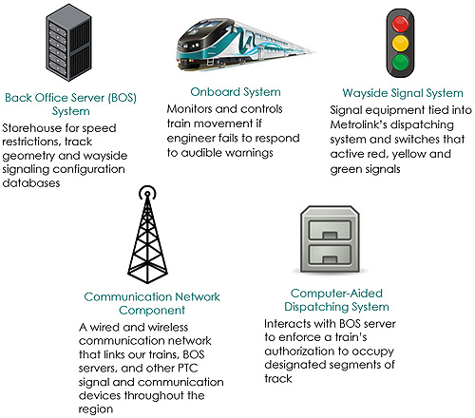
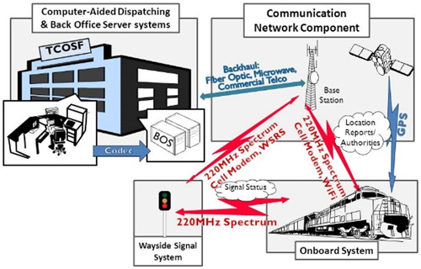

Slide 14
Challenges Faced By IOT technology in transportation
Security breaches
As the number of network-connected devices and sensors continues to grow exponentially, measures must be taken to protect sensitive data and networks. Ensuring that all IoT devices are compliant with an organization’s security policies is important. Other considerations include data transmission encryption, user access control, and device authentication.
Extended network infrastructure
The proliferation of IoT devices will make it necessary for organizations to work with larger data capacity and manage more IP addresses. The network infrastructure supporting an IoT solution must be able to handle the constant communication and collection of data from sensors and IoT devices. Most IoT solutions’ data outputs grow as more automated workflows and controls are added to each program. So, it is important that networks have the capacity to easily scale as organization and program needs evolve.

Slide 15
CONTD...
Increase in investment
The adoption of IoT technology is expected to result in savings and operational optimizations for most organizations, but it can require a significant investment. Some of the costs associated with an IoT solution deployment include network infrastructure; implementation downtime; retrofitting vehicles or machines to be directly connected to an IoT device; customization, configuration, and training; security; and the cost to plan, implement, and manage the IoT solution.

Slide 16
Conclusion
IOT would support innovation in the transportation industry. We should harness the power of IoT. But unfortunately the adoption rate of IoT in transportation is very low.
However, this will change soon and we will see IoT being incorporated into vehicles, which will greatly impact the industry and present new opportunities that seemed impossible a few years back.

